Slide 1
On demand Course Production and design

Slide 2
Process Infos
Curriculum Blueprint
Priorities
Raw Content
Production
& Design
Set-up
Visibility
Promotion
Feedback
Owner name | Damien Lerminiaux
Interfacing team(s): | Production and design / Curriculum Architect / SME
Reference document: | Project Tracking (aka Chunking Guide)
Tools involved: | Articulate
Input: | Storyboard in PPT (Process ?)
Output: | ON demand Training Material In Scorm (Process?)
Name | Damien | Don | Mauro | Valérie | Gary | Marc | Aurelia | Uli | Other
Date |  |  |  |  | Dec 18

Slide 3
Basic Principles
Every On-demand training production starts with a meeting between the CA and the P&D team member in charge
Progress is shared during the weekly Prod meeting and written in the One Note document for that meeting
All deliverables and document links related to the TM are stored in the Project tracking Excel Sheet

Slide 4
Steps
Launch
Production and design
Validation on Articulate 360
SCORM editing on repository
1
2
3
4

Slide 5
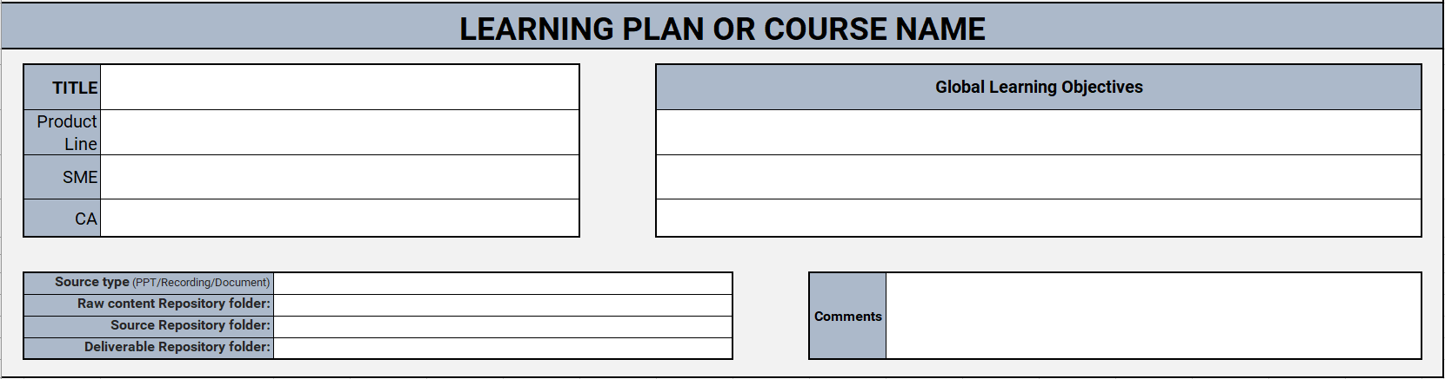
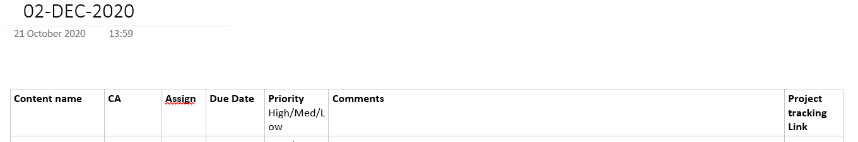
1 Launch
A meeting takes place, via teams, between CA and Design team Member to present the Learning Plan and project specific details, as well as sharing the link to the project tracking sheet (aka chunking guide).
Priority evaluation and Production follow up will be shared during Production meeting once a week, details stored In the One note document

Slide 6
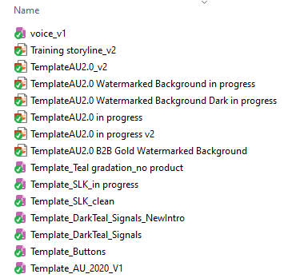
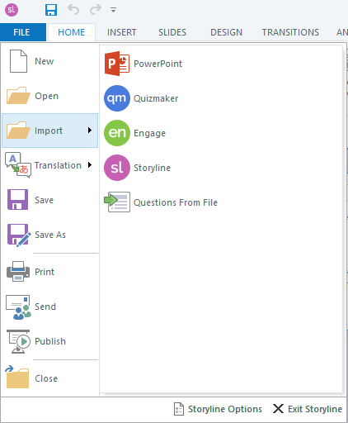
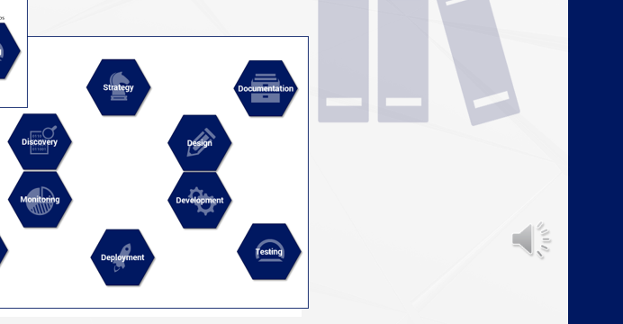
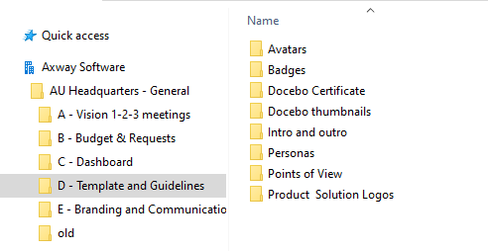
2 Production and design
Select the corresponding Storyline Template in the Packaging team folder in Syncplicity
Copy the PPT to your computer before importing it on storyboard
Check for missing elements such as audio tracks or images.
Animate, sync and design using the corporate image folder on teams. Or, create what is needed.
If the story board is used for Webinar sessions, all edits should take place inside the source PPTX for consistency. This should be clarified during the CA brief and / or in the project track document.

Slide 7
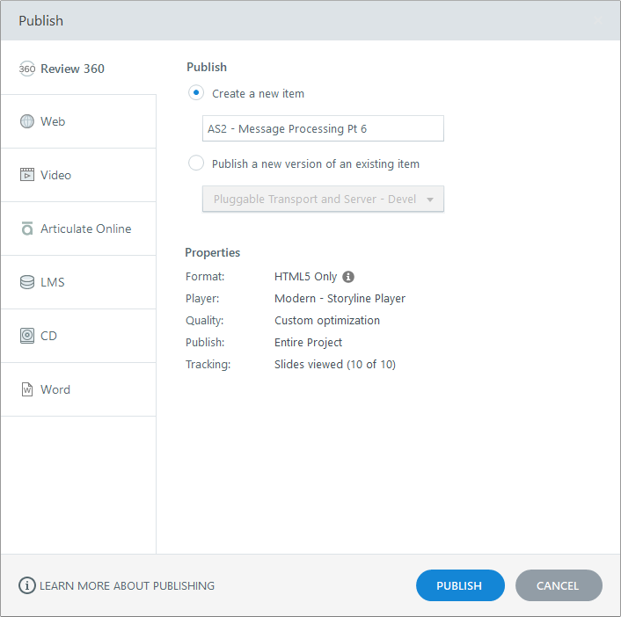
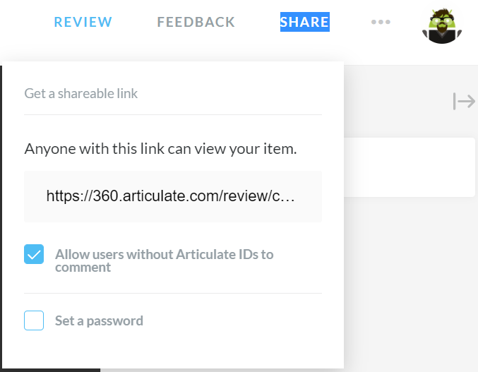
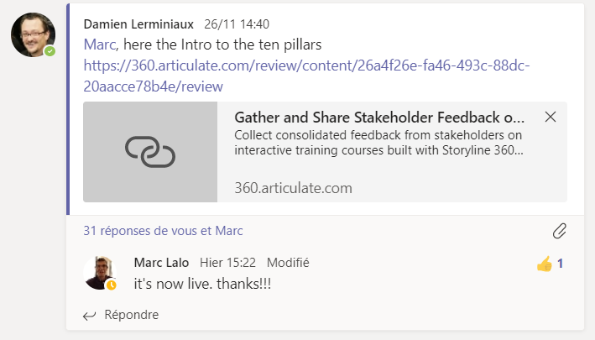
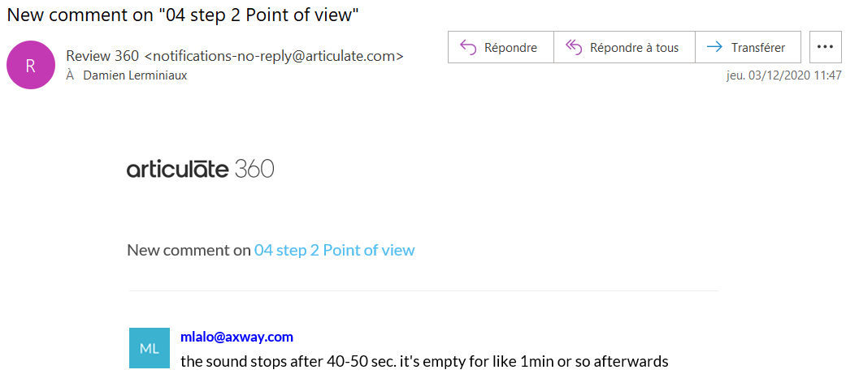
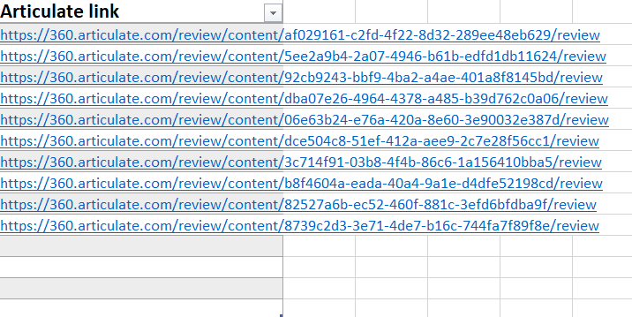
3 Validation on Articulate 360
Once the training material is ready, publish to Review 360 for validation
Insert the link to the TM on the project tracking guide
Send a message to the CA on the Production Team teams channel
Check for update by email and/or on the platform

Slide 8
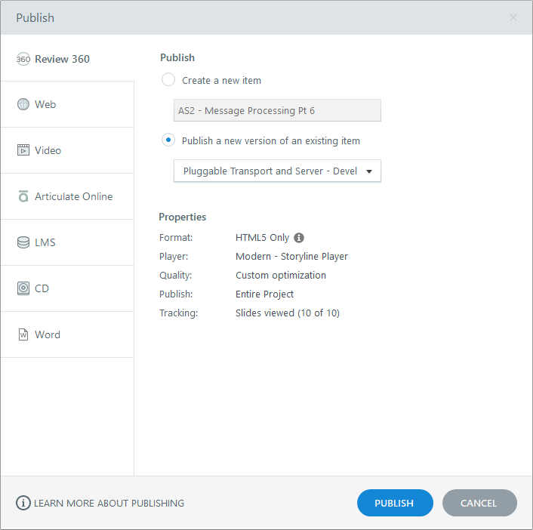
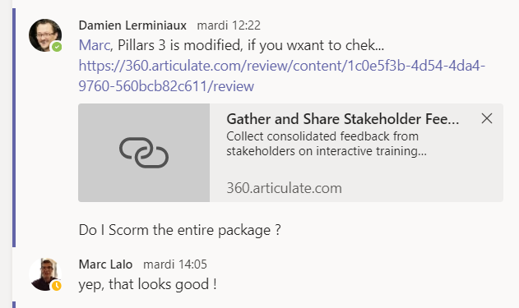
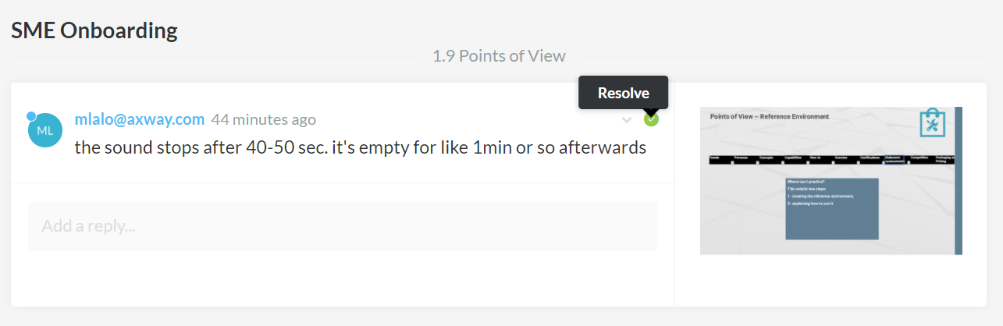
3 Validation on Articulate 360
Do the modification or ask for clarification using the feedback section
Re-publish for final validation
Ask/wait for final word from CA

Slide 9
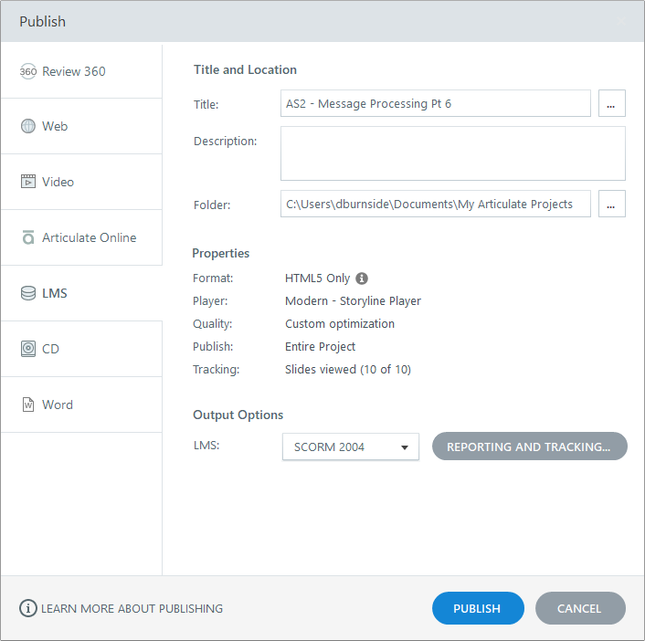
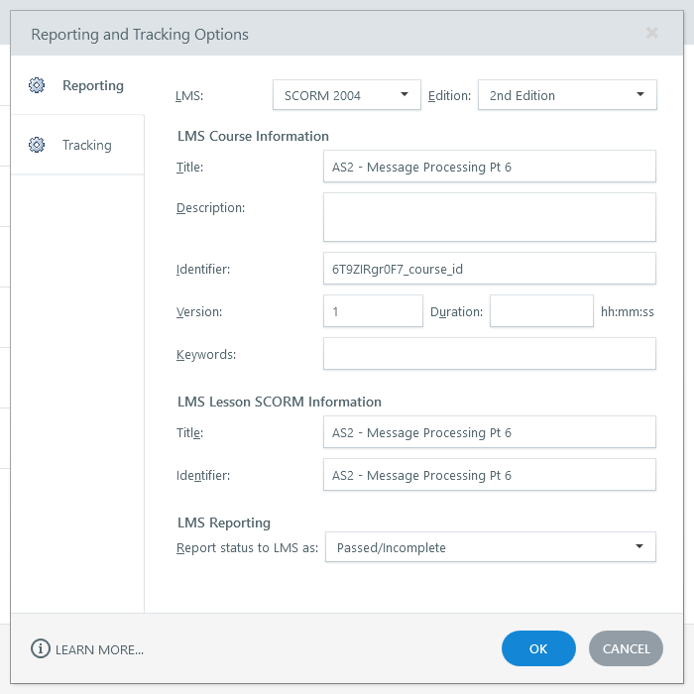
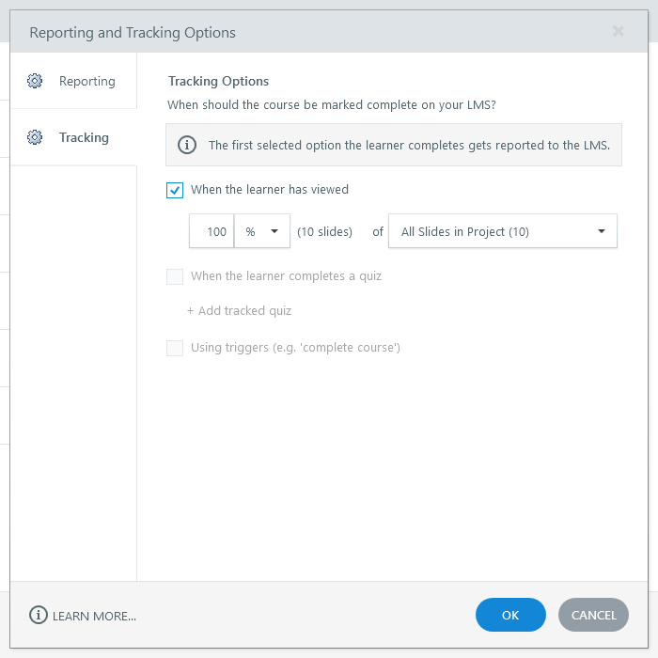
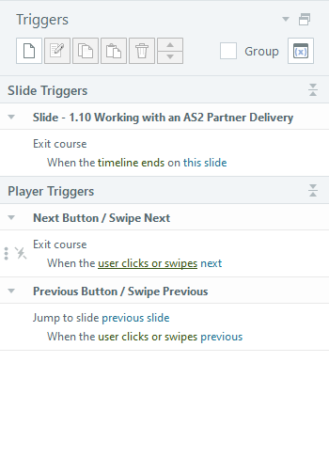
4 Scorm editing on repository
Check the triggers on the last and final slide (Exit at the end of the timeline / and exit module when the user click Next
Export the TM as SCORM 2004
Check the Name and Code of the module on the report section
Check the validation option

Slide 10
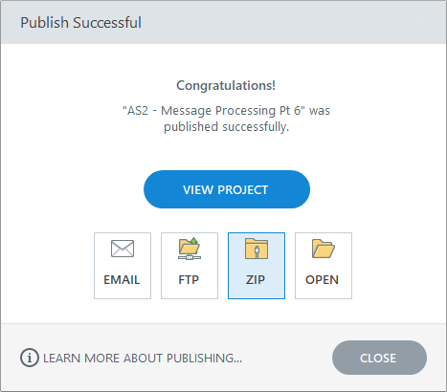
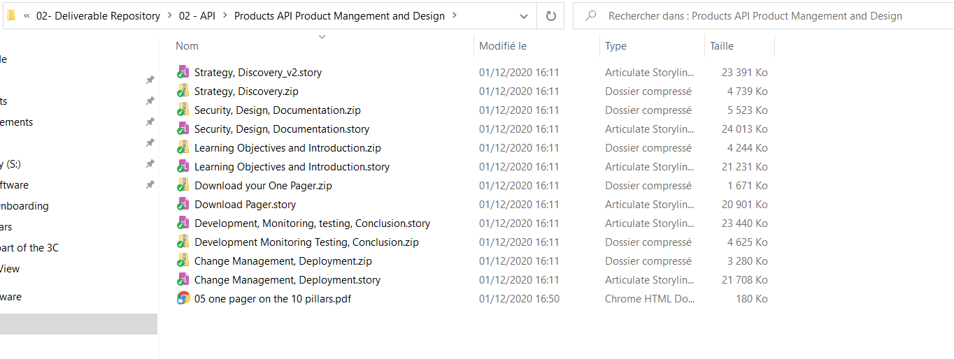
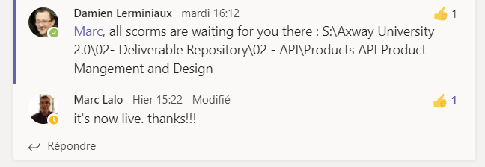
4 SCORM editing on repository
ZIP it using storyline at the end of the export
Create the same folder in the Deliverable repository as in the Source repository and place both the Storyline source file and the SCORM Zip file there
Once the entire learning plan is uploaded to the LMS, validation links will be removed and become non-operational in a matter of weeks.
Send a message to the CA when ready

Slide 11
Summary
Every project related document is listed and linked in the Project tracking sheet
Every Project tracking sheet is listed in the One Note document for the production weekly meeting
Never talk about the fight club
Process linked :
Before: raw Content exchange with SME
After: Training Data base with Deli

Slide 12
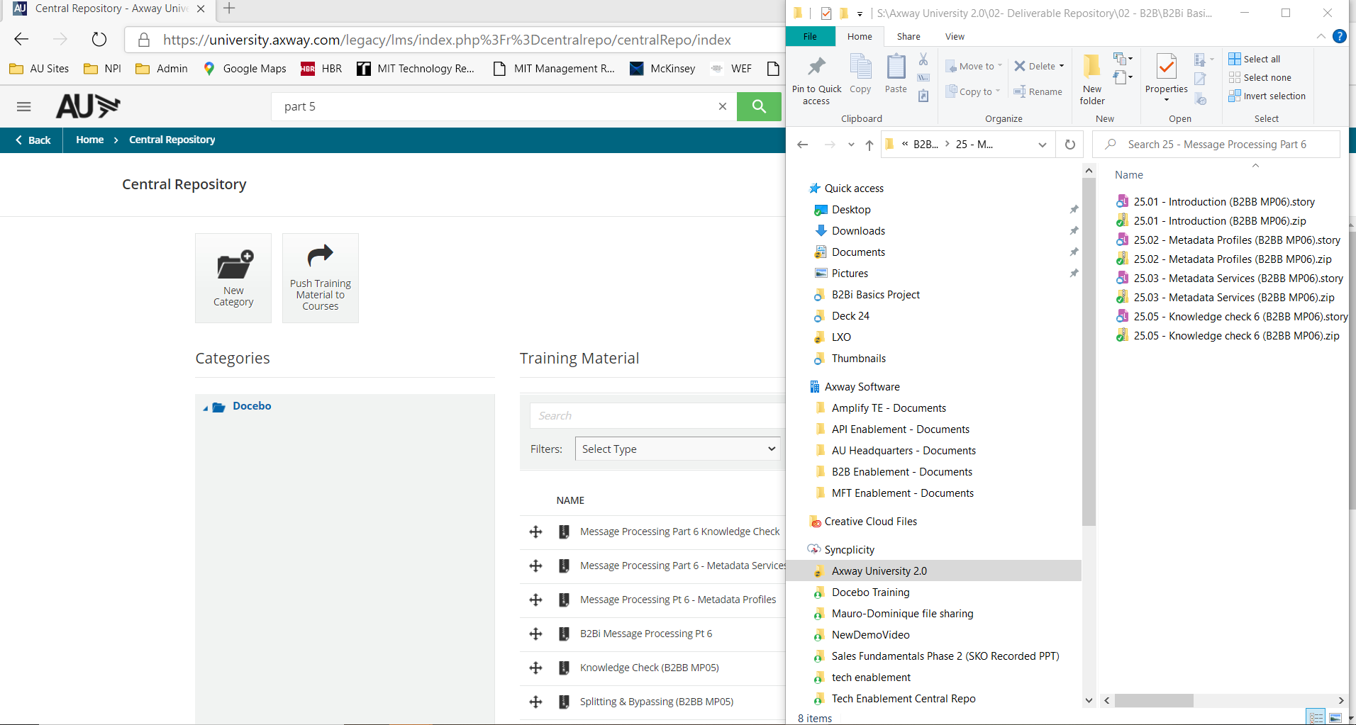
Importance of exact same name everywhere

